Slide 1
Changes to the Primary Care Extended Access Service in Warrington Vicky Ellis-Brown, PCN Manager, Central and West Warrington (CWW) Primary Care Network (PCN) Marie-Ann Hunter, PCN Strategic Manager, for Central East Warrington, East Warrington and South Warrington Primary Care Networks (PCNs) Calum Meakin, PCN Deputy Manager for Warrington Innovation Network (WIN)

Slide 2
PCN Representatives Hannah Thomas (PCN Support) and Lauren Haslam (Care Coordinator) – South Warrington Network Representatives

Slide 3
Advisory Note
Please note that the changes being discussed today DO NOT affect access to your GP surgery. Contacting your Practice regarding your personal health will remain unaffected.
The same applies to the Out of Hours Service which is also based at Bath Street Health and Wellbeing. This service will remain unaffected by the changes taking place.

Slide 4
What is a Primary Care Network
PCNs were announced as part of NHS England’s Long Term Plan in January 2019. They have been put in place to improve and extend the range of services that are available in the community and join up the care that is provided from different organisations.
It is expected that by practices working together with a range of local providers, including community services, social care and the voluntary sector, they will be able to make resources go further.
Each PCN looks after approximately 30,000 – 50,000 patients, although some may have slightly more or fewer patients than that. PCNs will offer care on a scale which is small enough for patients to get the continuous and personalised care they value, but large enough to be resilient through working in partnership with others in the local health and care system.

Slide 5
Which PCN do I belong to?

Slide 6
Purpose of this Consultation
On 1st March 2022, NHS England published the updated GP contract regulations for 2022/23. The contract includes arrangements for a new Enhanced Access service, which is the further development of two existing services, known as extended hours service and extended access service.
This new service aims to improve patient access to primary care. The five Primary Care Networks in Warrington are consulting with their patient populations to ensure the new enhanced access service is fit for purpose and meets the local needs of patients

Slide 7
Current Services
Currently patients in Warrington have the opportunity to access two types of Extended Access Services outside of core General Practice hours (08:00-18:30):
CCG commissioned Extended Access
Extended Access to primary care was introduced by NHS England in 2016 to ensure everyone has easier and more convenient access to GP services. In Warrington this service, via face to face and online appointments is:
currently delivered by Quay Healthcare CIC from Bath Street Health and Wellbeing Centre on Legh Street
available at evenings and weekends
2. NHS England commissioned Extended Hours Access
Extended Hours Access was first introduced in July 2019 by NHS England to further enhance access to GP services. In Warrington this service, via face to face and online appointments is:
currently delivered from GP Practices to all registered patients within their respective PCN
available at evenings, weekends and early mornings

Slide 8
Why is this changing?
The NHS has been changing a lot recently, with new initiatives and organisations being developed by the Government.
With the national developments of PCNs, the funding and responsibility for Extended Access must transfer from the CCG to the PCNs by October 2022.
NHS England directs that the new Enhanced Access arrangements aim to remove variability and improve patient understanding of the service. The new offer is based on PCNs providing bookable appointments outside core hours, utilising the full multi-disciplinary team, and offering a range of general practice services, including ‘routine’ services such as screening, vaccinations and health checks, in line with patient preference and need.”

Slide 9
What are the changes?
This Photo by Unknown Author is licensed under CC BY-SA

Slide 10
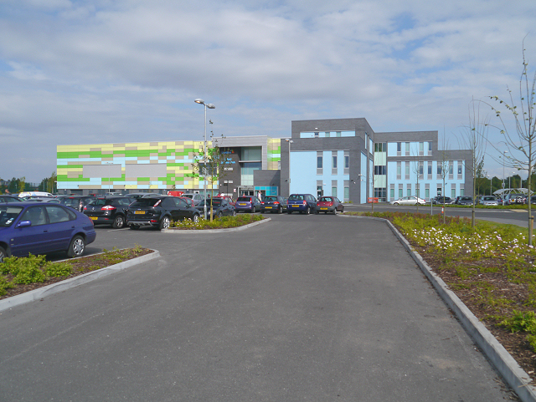
Collaborative PCN Proposal
The Collaborative PCN, is four PCNs across Warrington working together to deliver Extended Access Services.
Pilot service since August 2021
Hub & Spoke model (Orford Jubilee and GP locations across the town)
498 (97%) positive comments from people who have used the service during the pilot
Central location
Accessible
This Photo by Unknown Author is licensed under CC BY-SA

Slide 11
Proposed Model
Collaborative PCN Proposal
All collaboration networks
Warrington Innovation Network
South Warrington Network
East and Central East Networks
 | 4 Seasons Medical Centre | Parkview Medical Centre | Latchford Medical Centre | Stockton Heath Medical Centre | 1 Manchester Road | Orford Jubilee Hub
Monday | 6.30pm – 8pm |  | 6.30pm – 8pm |  | 6.30pm – 8pm
Tuesday | 6.30pm – 8pm |  | 6.30pm – 8pm |  | 6.30pm – 8pm
Wednesday |  | 6.30pm – 8pm |  | 6.30pm – 8pm | 6.30pm – 8pm
Thursday | 6.30pm – 8pm |  |  | 6.30pm – 8pm | 6.30pm – 8pm
Friday |  |  |  |  |  | 6.30pm – 8pm
Saturday |  |  |  |  |  | 8am-4pm
Sunday |  |  |  |  |  | 10am-2pm

Slide 12
Your views matter!
We are looking for your views on the new Enhanced Service and a formal 12 week public consultation is now underway, between Tuesday 3rd May – Sunday 26th July 2022.
You can contact the Collaborative PCN with your feedback via:
warccgextaccesscic@nhs.net
You can also contact NHS Warrington CCG, who are supporting PCNs, to give your comments via email or telephone, below:
warccg.halccg.commseng@nhs.net
01925 30 30 30
More information can be found on the CCG website
www.haltonwarringtonccg.nhs.uk

Slide 13
Where can you find us next?
We are hosting drop in sessions at the spoke sites whilst the consultation is running between Tuesday 3rd May – Sunday 26th July 2022.
Our next one is:
Saturday 28th May - 1st Floor Orford Jubilee, between 10am and 1pm

